Slide 1
Weather Monitoring System
Guided by :- Prof. Santosh Kamble

Slide 2
Table Of Contents :-
01
02
03
04
List of Components
Block Diagram
Circuit Diagram
ThingSpeak
Components and Total cost
Basic Process
Circuit diagram and Proteus simulation
Code and Output results

Slide 3
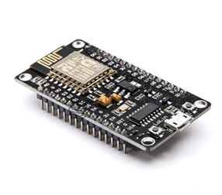
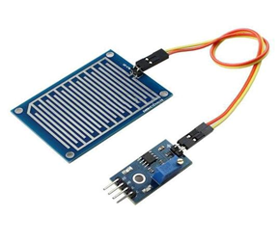
Components :-
Nodemcu
Rain sensors

Slide 4
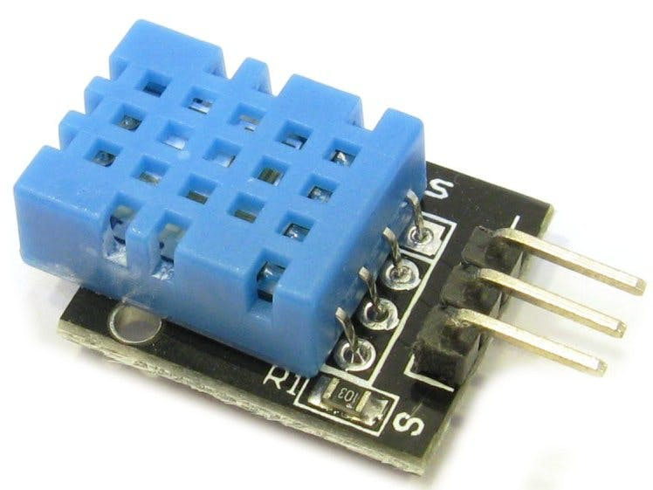
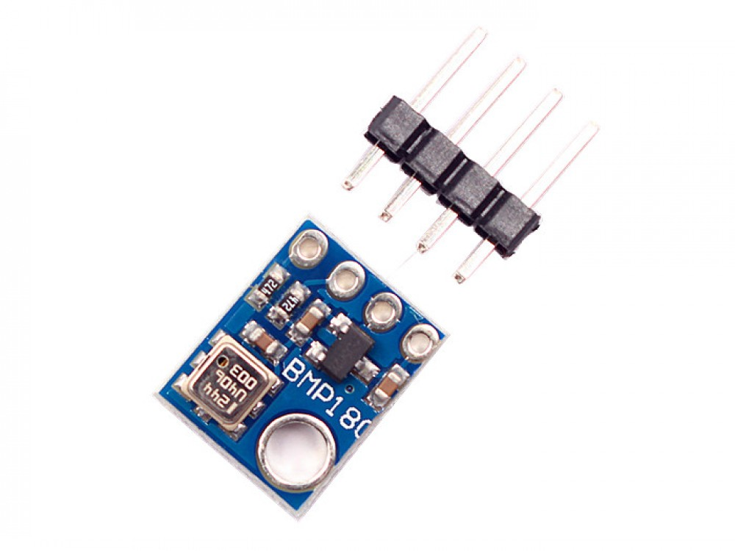
Components :-
DHT11
BMP180

Slide 5
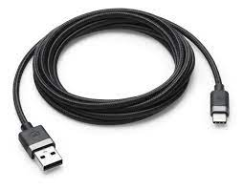
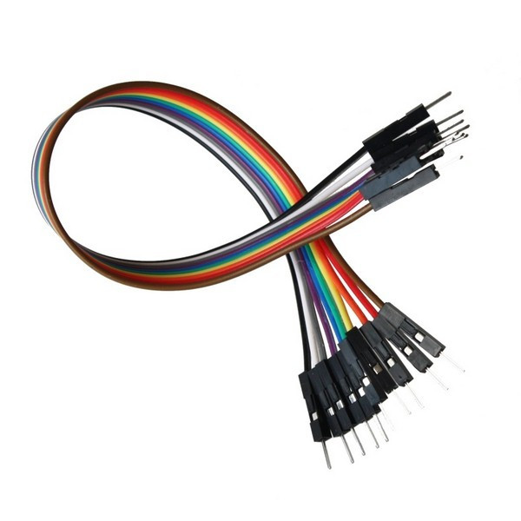
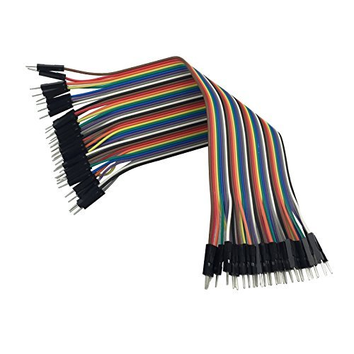
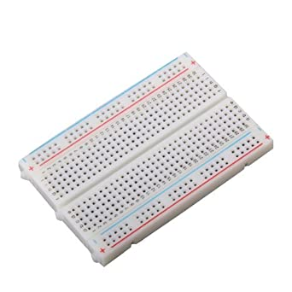
Components :-
Other components
Bread board
Jumper wires
USB cable
Total cost
Rs.1000

Slide 6
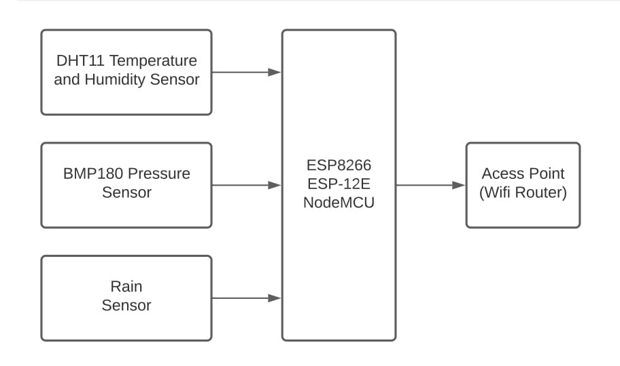
Block Diagram:-

Slide 7
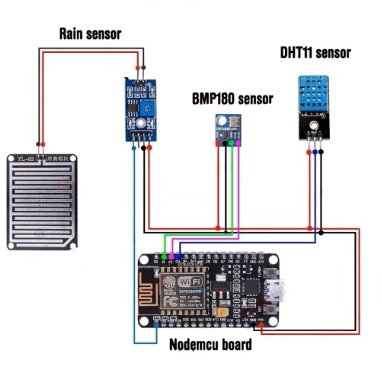
Circuit Diagram:-

Slide 8
Code :-
#include <Adafruit_Sensor.h>
#include <SFE_BMP180.h>
#include <Wire.h>
#include <ESP8266WiFi.h>
#include <DHT.h>
DHT dht(D3, DHT11);
SFE_BMP180 bmp;
double T, P;
char status;
WiFiClient client;
String apiKey = "MOPMRWA0A45FZU1W";
const char *ssid = "Skyworth_0A97C9";
const char *pass = "00000000";
const char* server = "api.thingspeak.com";
void setup() {
Serial.begin(115200);
delay(10);
bmp.begin();
Wire.begin();
dht.begin();
WiFi.begin(ssid, pass);
while (WiFi.status() != WL_CONNECTED) {
delay(500);
Serial.print(".");
}
Serial.println("");
Serial.println("WiFi connected");
}

Slide 9
Code :-
void loop() {
//BMP180 sensor
status = bmp.startTemperature();
if (status != 0) {
delay(status);
status = bmp.getTemperature(T);
status = bmp.startPressure(3);// 0 to 3
if (status != 0) {
delay(status);
status = bmp.getPressure(P, T);
}
}
//DHT11 sensor
float h = dht.readHumidity();
float t = dht.readTemperature();
if (isnan(h) || isnan(t)) {
Serial.println("Failed to read from DHT sensor!");
return;
}
int r = analogRead(A0); //Rain sensor
r = map(r, 0, 1024, 0, 100);
if (client.connect(server, 80)) {
String postStr = apiKey;
postStr += "&field1=";
postStr += String(t);
postStr += "&field2=";
postStr += String(h);
postStr += "&field3=";
postStr += String(P, 2);
postStr += "&field4=";
postStr += String(r);
postStr += "\r\n\r\n\r\n\r\n";
}

Slide 10
Code :-
client.print("POST /update HTTP/1.1\n");
client.print("Host: api.thingspeak.com\n");
client.print("Connection: close\n");
client.print("X-THINGSPEAKAPIKEY: " + apiKey + "\n");
client.print("Content-Type: application/x-www-form-urlencoded\n");
client.print("Content-Length: ");
client.print(postStr.length());
client.print("\n\n\n\n");
client.print(postStr);
Serial.print("Temperature:");
Serial.print(t);
Serial.println("°C");
Serial.print("Humidity: ");
Serial.print(h);
Serial.println("%");
Serial.print("absolute pressure: ");
Serial.print(P, 2);
Serial.println("mb");
Serial.print("Rain:");
Serial.println(r);
}
client.stop();
delay(1000);
}

Slide 11
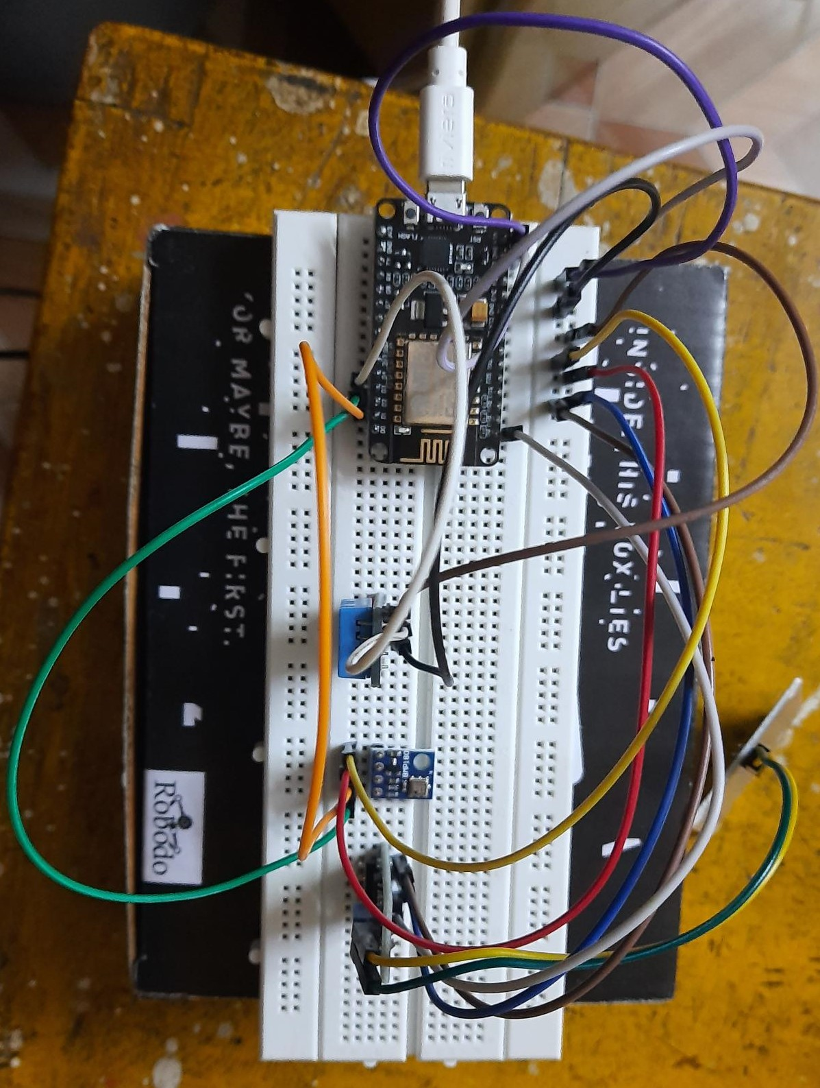
Implementation :-

Slide 12
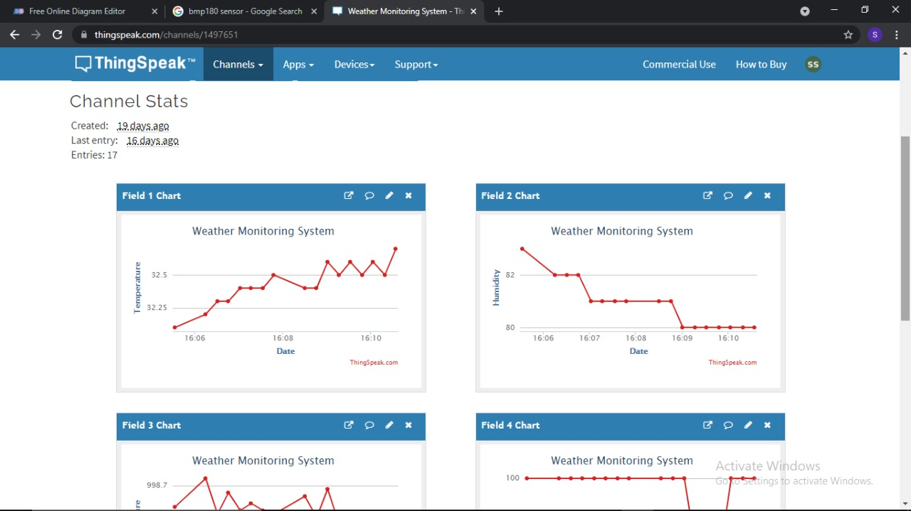
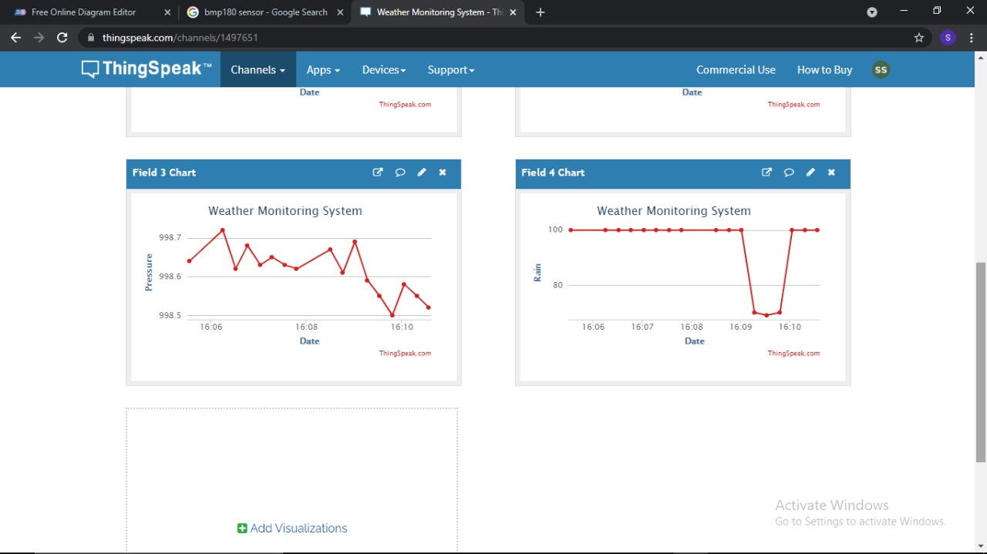
ThingSpeak Output :-

Slide 13
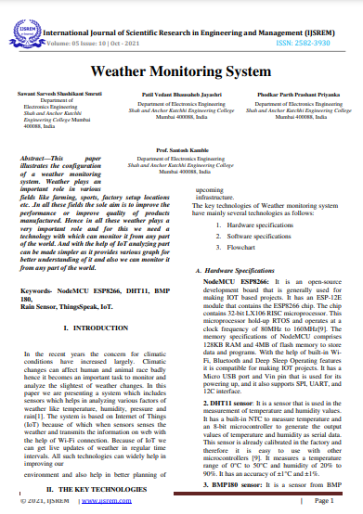
Published Paper :-

Slide 14
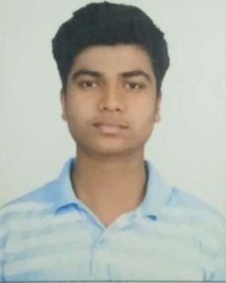
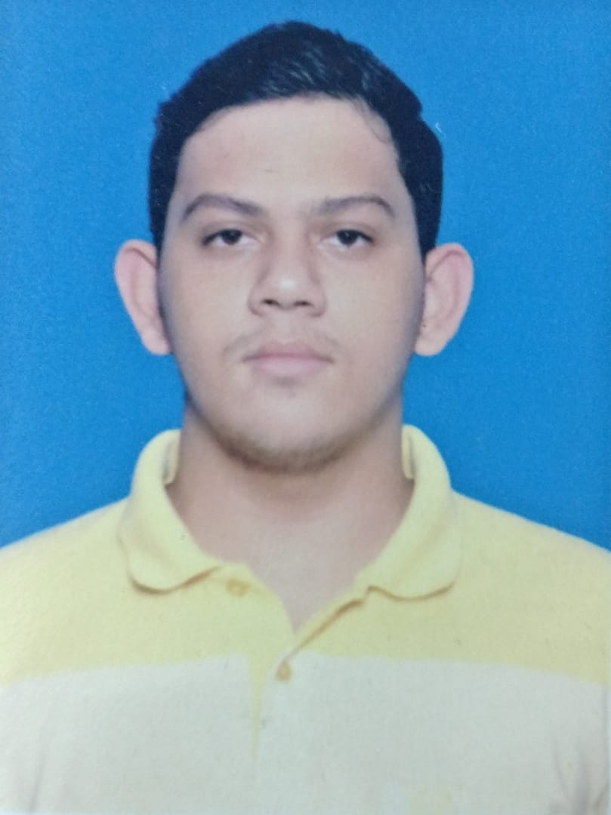
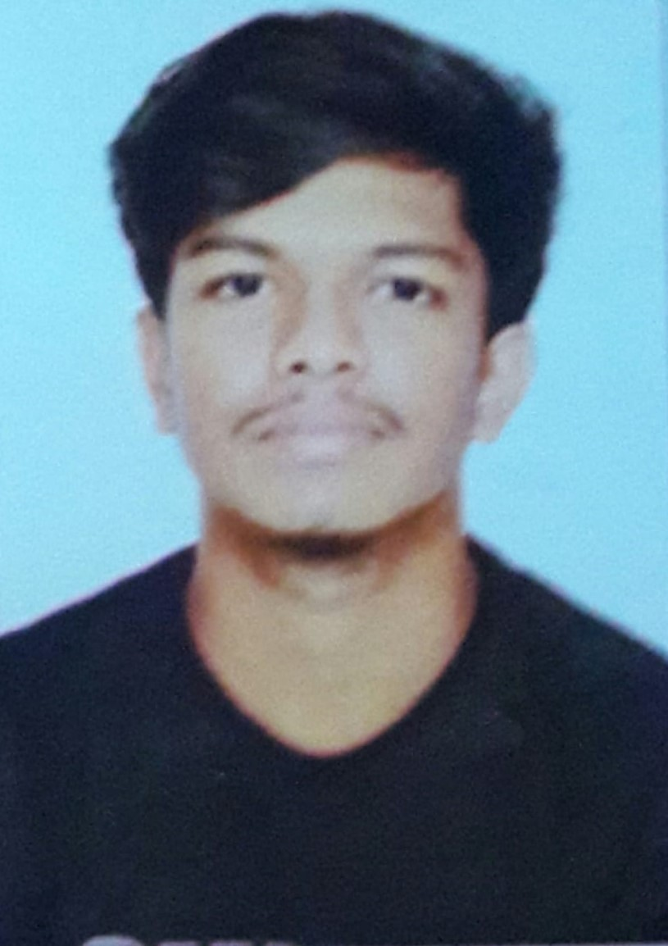
Our Team :-
Vedant Patil
Parth Phodkar
Sarvesh Sawant
TE
Electronics Engineering
Roll no - 17
TE
Electronics Engineering
Roll no - 18
TE
Electronics Engineering
Roll no - 23

Slide 15
THANK YOU

